Slide 1
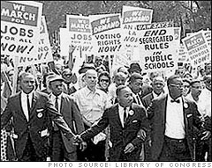
The March on Washington
Mark Britt

Slide 2
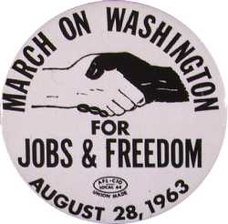
Facts #1
The March was created to push for Jobs and Freedom.
This was one of the largest political rallies for human rights in United States history.
This march was called for civil and economic rights for African Americans.
The march was created by a group of civil rights, labor, and religious organizations to fight for the rights of African Americans.
"March on Washington for Jobs and Freedom
(wikipedia)

Slide 3
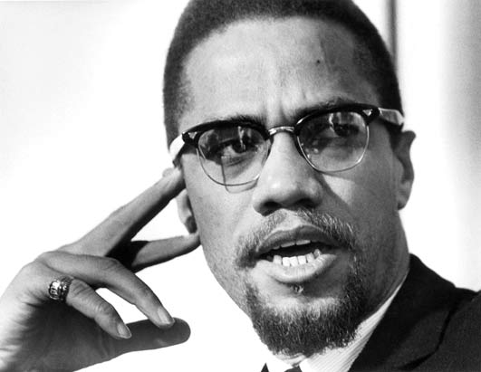
Facts #2
The march was planned by a man named A. Philip Randolph.
The march was not fully supported among most civil rights activists.
The march was condemned by Malcolm X.
March organizers themselves disagreed on the purpose of the march knowing it was going to cause problems.
"March on Washington for Jobs and Freedom
(wikipedia)

Slide 4
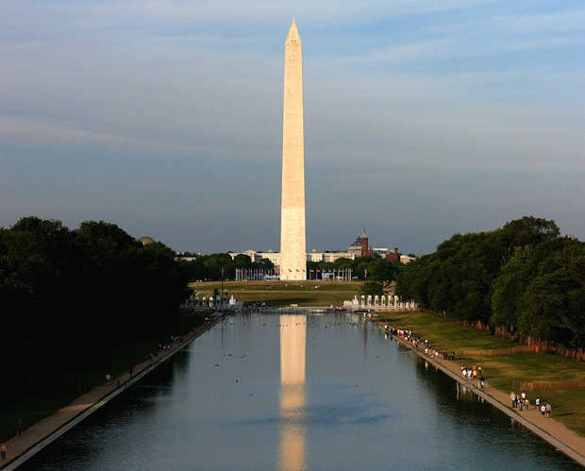
Facts #3
On Aug. 28, tons of people filled transformational vehicles.
The march began at the Washington Memorial and ended at the Lincoln Memorial.
"March on Washington for Jobs and Freedom."
(wikipedia)

Slide 5
Reflection Slide
The most interesting piece of my research would have to have been how much of an impact this had on society and how many people backed up this idea.
My research enhanced my understanding of Jim Crow Laws in the South and the Civil Rights movement because it was very hard for African Americans and I now fully understand what they went through.
I organized my information based on importance and what other people should know.

Slide 6
Work Cited Slide
<http://en.wikipedia.org/wiki/March_on_Washington _for_Jobs_and_Freedom >.

